Slide 1

KIT - Kalaignarkarunanidhi Institute of Technology (An Autonomous Institute)
Department of Computer Applications M23CAP401– PROJECT WORK
GUIDED BY,
PRESENTED BY,
Dr E .VIJAYAKUMAR MCA.,Ph.D.,
GANESH.A(711524MMC010), DEPARTMENT OF MCA.
ASSOCIATE PROFESSOR,
HEAD OF DEPARTMENT.

Slide 2
PROJECT TITLE:
Smart Answering System using
Retrieval-Augmented Generation (RAG)

Slide 3
ABSTRACT
Developed a Smart Answering System using Retrieval-Augmented Generation (RAG).
Understands user questions in natural language.
Retrieves relevant information from uploaded documents before generating answers.
Converts documents into vectors for efficient semantic search.
Stores vectors in a vector database for fast information retrieval.
Uses an open-source Large Language Model (LLM) to generate context-based responses.
Reduces hallucination by grounding answers in retrieved documents.
Handles large volumes of data efficiently.
Suitable for Researchers, Developers, Data Analysts, and Corporate Professionals.

Slide 4
EXISTING SYSTEM
Uses only keyword-based search without semantic understanding.
Primarily works with plain text and struggles to process PDFs or images effectively.
Stores data in traditional databases without contextual understanding.
Generates answers without validating information, leading to possible incorrect responses.
Cannot efficiently handle large unstructured data such as scanned documents.
Performance decreases as data size increases.
Requires manual rule-based methods for information extraction.
Provides less accurate answers for complex or multi-part queries.
Not suitable for real-time intelligent applications.
Does not utilize modern AI techniques or multimodal models.

Slide 5
PROPOSED SYSTEM
Can understand text, images, PDFs, and scanned documents in one system
Supports different file formats and adjusts automatically
Uses open-source AI models with a smart agent to understand user questions
Converts all data into vector form so the system can understand meaning
Stores the data in a vector database for quick access
Smart agent analyzes and improves the user question if needed
Finds the most relevant information based on the question
Thinks step-by-step to generate accurate answers
Gives clear, explainable, and context-based responses
Useful for chatbots, research, document analysis, and decision making

Slide 6
SYSTEM SPECIFICATION
HARDWARE
Processor: Intel Core i5 or higher
RAM: Minimum:16 GB
Storage: Minimum 512 GB HDD/SSD
System Type: 64-bit computer
SOFTWARE
Operating System: Windows 11, Linux, or macOS
Programming Language: Python 3.10 or above
Database:MYSQL, Chroma Vector Database
Tools: VS Code

Slide 7
SYSTEM MODULES
Modules 1-Login page Module
Modules 2-User Interface Module
Modules 3-Query Input & Preprocessing Module
Modules 4-Embedding Generation Module
Modules 5-Information Retrieval Module
Modules 6-Responses Generation Module
Modules 7-Database Module

Slide 8
Module description
Modules 1-Login Page Module
Authenticates users to securely access the Smart Answering System
Stores login details in MySQL and enables controlled system usage
Modules 2-User Interface Module
Provides interface to enter queries and view AI-generated answers
Displays previous queries and responses for easy reference.
Modules 3 -Query Input & Preprocessing Module
Processes user queries by cleaning and structuring input text
Prepares queries for embedding to improve RAG-based retrieval accuracy

Slide 9
Modules 4-Embedding Generation Module
Analyzes user intent and rewrites complex or unclear queries if necessary.
Plans intelligent retrieval steps to improve answer accuracy.
Moduels 5-Information Retrieval Module
Combines retrieved information with the user query to generate structured and responses.
context
based
Ensures answers are meaningful, accurate, and grounded in the uploaded documents.
Modules 6-Response Generation Module
Generates accurate answers using LLM based on retrieved context
Combines query + documents to produce context-aware responses (RAG)

Slide 10
Modules 7-Database Module
Stores user data, documents, embeddings, and responses
Supports fast retrieval and efficient management of RAG pipeline data.

Slide 11
MODELS
Llama 3.1 8B (Large Language Model)
Used for text understanding, reasoning, and response generation
Powers RAG-based chat and intelligent answer synthesis
Qwen 2.5 VL (Vision-Language Model)
Processes and analyzes images along with text
Provides visual context understanding for multimodal queries
all-MiniLM-L6-v2 (Embedding Model)
Converts text into vector representations
Enables fast and accurate semantic search in the database

Slide 12
CLIP ViT-B/32 (Multimodal Embedding Model)
Encodes images and text into a shared vector space
Supports image search and cross-modal retrieval

Slide 13
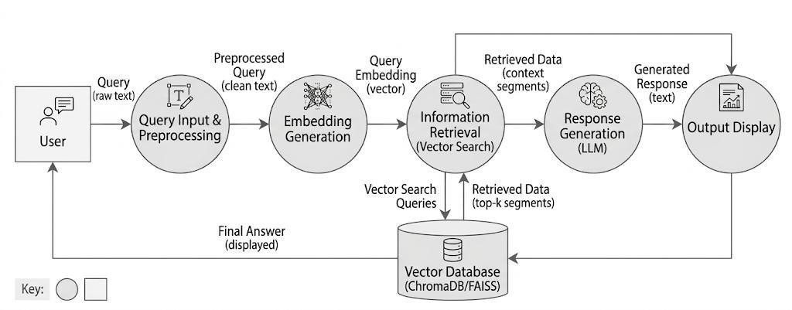
DATA FLOW DIAGRAM

Slide 14
SYSTEM TESTING
Testing phase ensures reliability, accuracy, and performance of the system
Validates functionality and identifies errors before deployment
Testing Types:
Unit Testing: Tests individual modules
Integration Testing: Ensures modules work together
Functional Testing: Verifies system functions as expected
Performance Testing: Checks speed and efficiency
Security Testing: Ensures data safety and protection
Validation Testing: Confirms system meets requirements

Slide 15
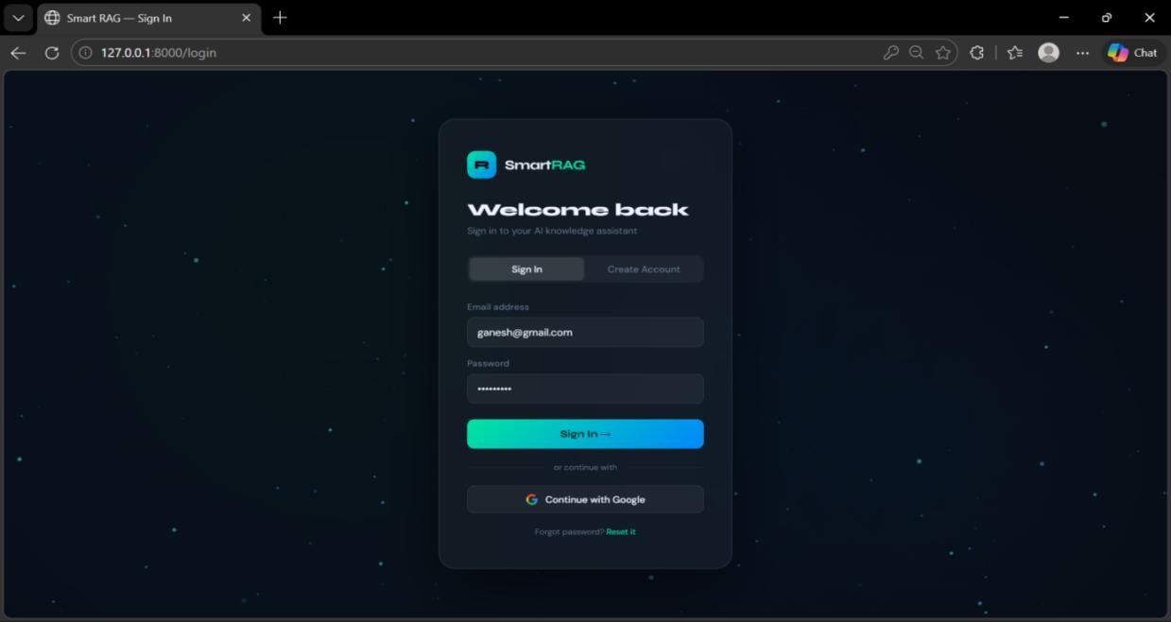
screenshot

Slide 16
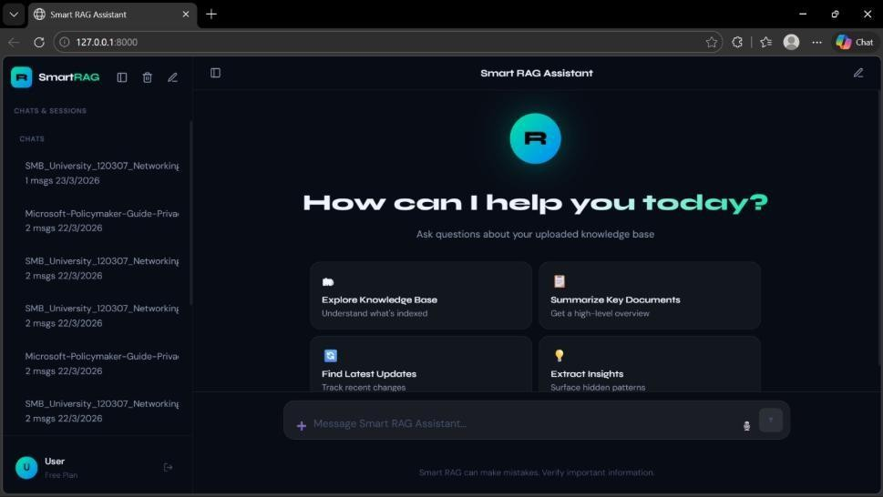

Slide 17
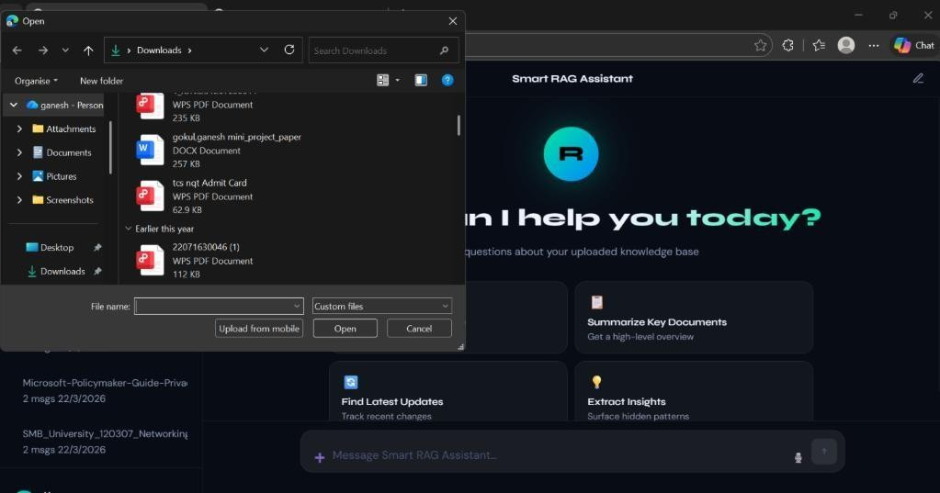

Slide 18
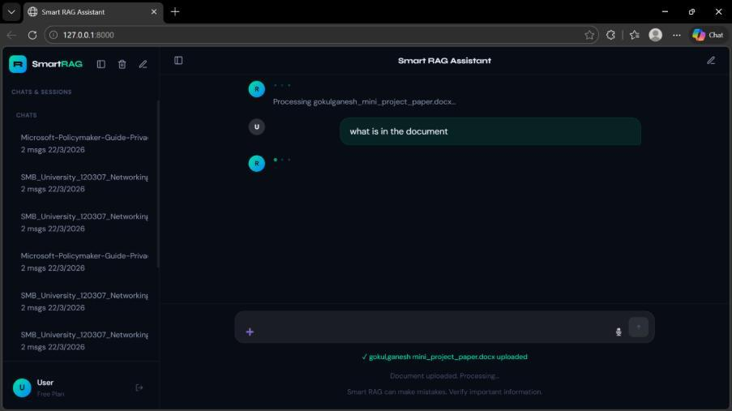

Slide 19
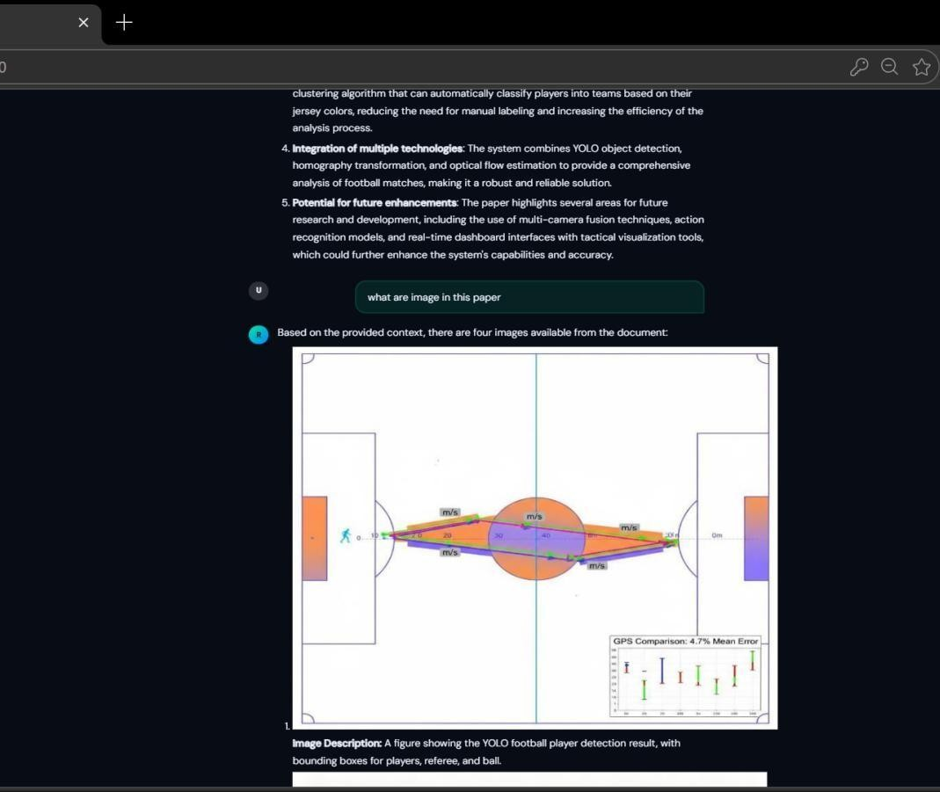

Slide 20
CONCLUSION
Developed a Smart Answering System using RAG for accurate and context-aware responses
Combines retrieval and AI models to overcome limitations of traditional systems
Provides fast, reliable, and meaningful answers in real time
Achieves high accuracy, efficiency, and user-friendly interaction
Suitable for applications like education, customer support, and knowledge systems
Scalable system with future scope for multimodal and real-time enhancements

Slide 21
FUTURE ENHANCEMENTS
Cloud Integration:
Integrate with AWS, Azure, or Google Cloud for scalable data handling
Collaboration:
Use real-world network data from organizations to improve accuracy
Scalability:
Enhance system to handle large-scale networks (banking, healthcare, telecom)
Visualization:
Add advanced charts, heatmaps, and predictive analytics for better insights

Slide 22
THANK YOU!

